Slide 1
Greek customs and traditions
“I am not a target”
2018-1-RO01-KA229-049059_6

Slide 2
Baptism
Baptismal day is one of the most important days in the life of a Greek Orthodox. It usually takes place the first year after the baby is born. On Baptism Day, the baby is undressed and wrapped in a white towel. The priest blesses the water and adds olive oil brought by the godparents. He then immerses the baby three times, saying the chosen name.

Slide 3
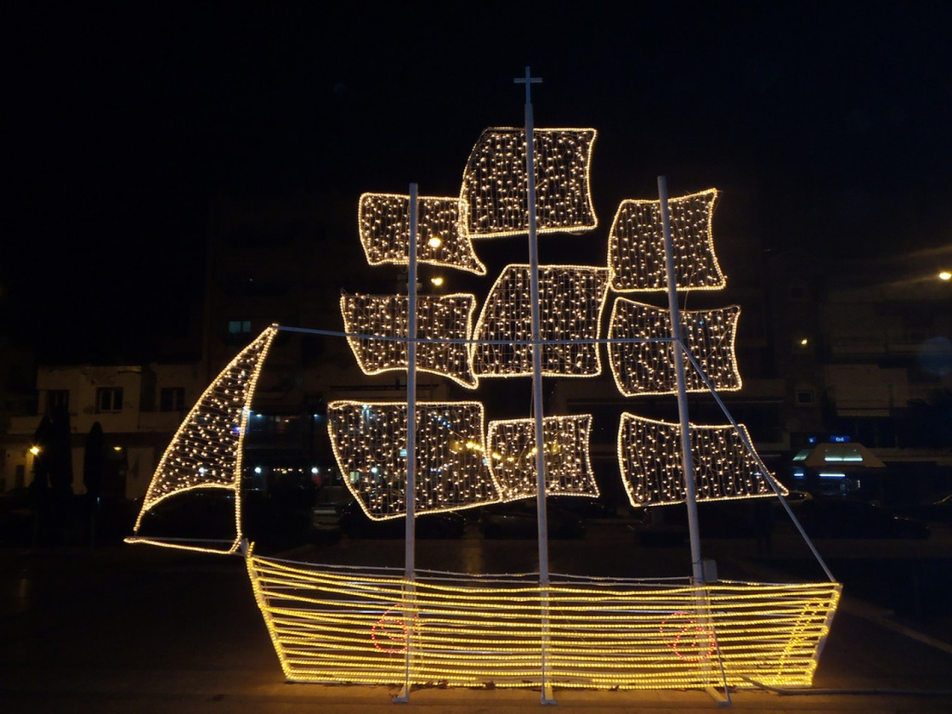
The Christmas Boat
Traditionally, Greeks didn’t decorate with a Christmas tree but a Christmas boat. As a symbol of the seafaring nation, the boat was decorated in honor of the sailors returning home to their families around Christmas time. Nowadays, the tradition is making a comeback, not only in the islands, but also on the mainland.

Slide 4
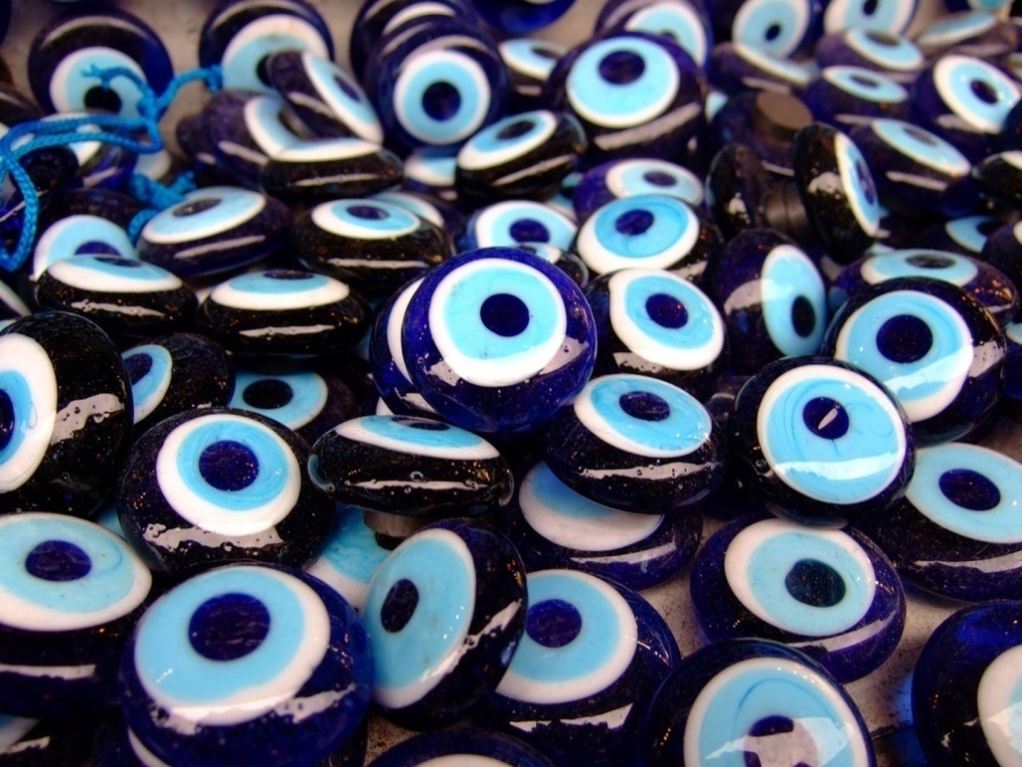
Evil Eye (Mati)
Perhaps the most notorious superstition is the belief that the evil eye is a curse (matiasma) cast by an envious or jealous person. To protect yourself against it, Greeks believe you must wear a charm. This is what the famous blue pieces of glass with an eye painted on are for.

Slide 5
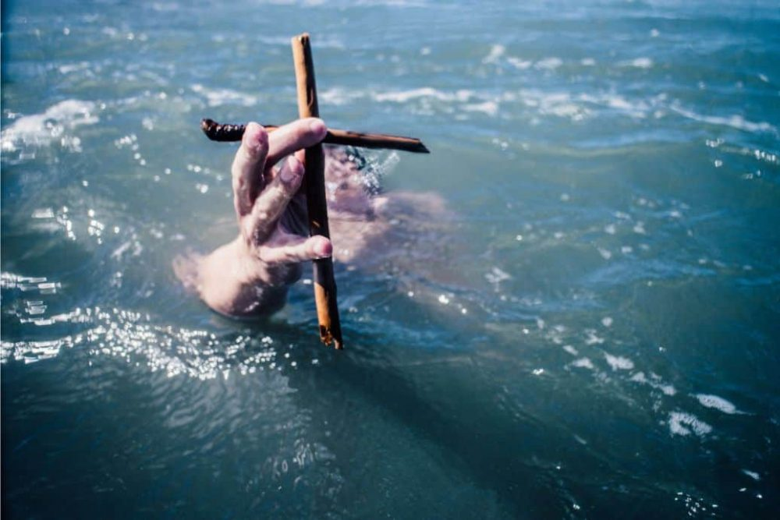
Epiphany – Catching the cross
Epiphany is one of the Public Holidays of Greece. On the 6th of January we celebrate the baptism of Jesus Christ by John the Baptist in the Jordan River. It is one of the most important days for all the Orthodox Christians, as it is a day of joy and brightness.

Slide 6
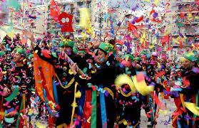
Apokries – the Greek Carnival
The Carnival is celebrated 3 weeks before the 40 days of fasting or Lent begin. The first week of the carnival starts with a specific church celebration. The second week is called Kreatini (from the word kreas, which means meat), and you are allowed to eat meat every day. The third and last week is called Cheese Week or White Week when you are not allowed to eat meat, just dairy and fish.

Slide 7
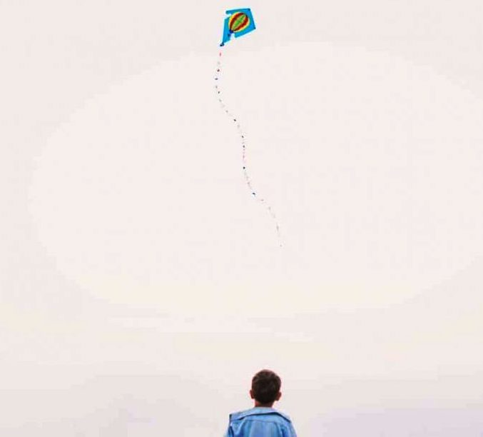
Kathara Deftera – Clean Monday
Clean Monday marks the end of the Greek Carnival and the beginning of the 40-days Lent.
According to Greek tradition, it is customary to fly kites on Clean Monday. Families go on outdoor excursions to beaches and open areas and usually have picnics if the day is pleasant. The flying of the kite is a symbol for the catharsis of the soul after the Carnival celebrations.
Clean Monday is a public holiday in Greece and Cyprus and is one of the most important Greek traditions.

Slide 8
Easter Celebrations
The whole of Holy Week is also full of traditions, with the dyeing of eggs (in red) to symbolize the sacrifice of Christ, the decoration of the epitaphios (the tomb of Christ) with flowers, and the many processions. The night of Holy Saturday is the pinnacle of celebrations, with a special ceremony that the majority of Greeks attend.

Slide 9
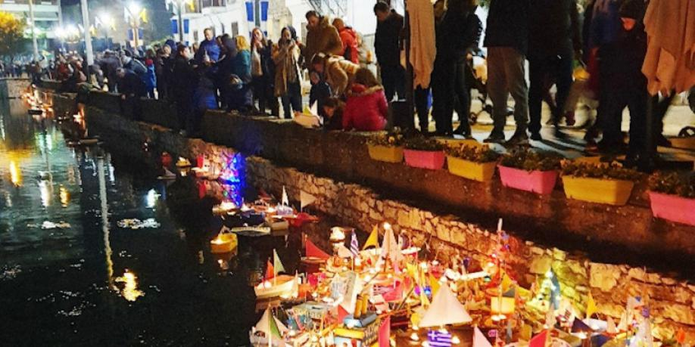
Old custom lights up Drama on St Barbara's feast
In the city of Drama, the waters of the fountains and springs of St. Barbara form a small lake in a verdant area, in front of the church with the same name
On the eve of the feast day in honor of Saint Barbara (December 4), parents with their children rush to the lakes of the city and release hundreds of paper boats carrying dozens of wishes of the children who made them.

Slide 10
Thank you

